Slide 1
Modules
There are mainly three modules which I have worked on.
1 . Speech To Text 2.Text to Speech
3. Real Time Web Search Module

Slide 2
Speech To TEXT Module
Used React-Speech-Recognition Library for conversion of Real time audio to text.
Created Two buttons for for Audio to Text Generation Start and Another for pause.

Slide 3
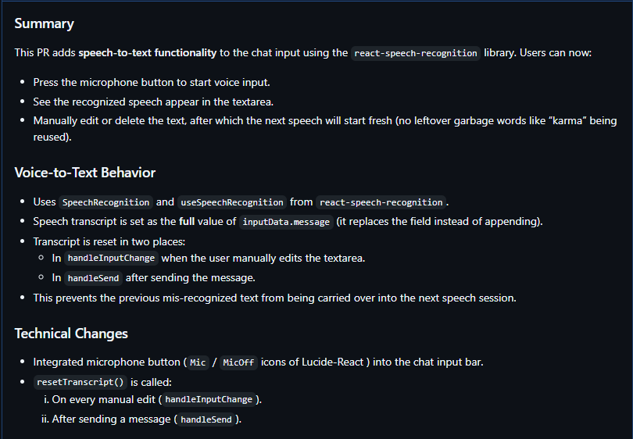

Slide 4
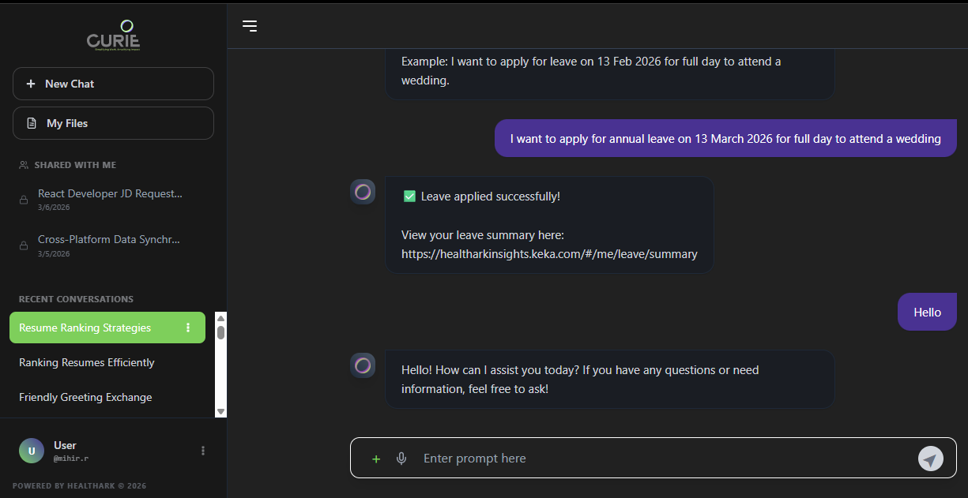

Slide 5
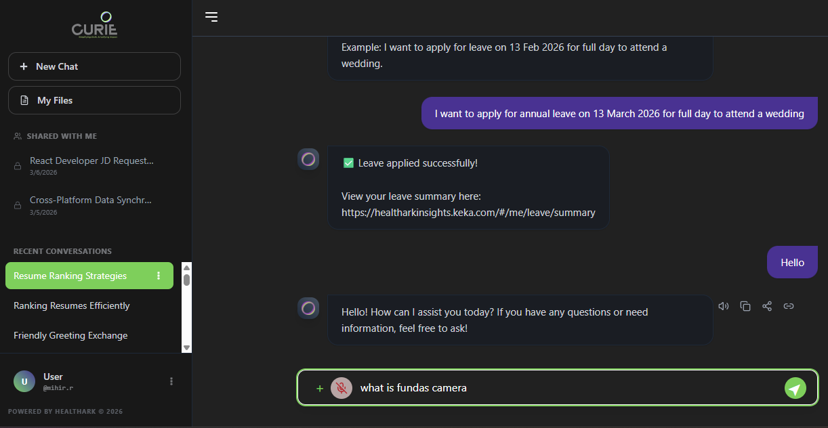

Slide 6
Text TO Speech Module
Used Browsers Native Speech Synthesis to Generate audio directly from browser for low latency.

Slide 7
Initially used piper voice models
At its first stage Piper Voice Models were used to generate audio from text.
Piper Models are light weight models that gives best results while being lightweight.
But due to Multiple Users this voice models were having concurrency issues so after that they got replaced.
In this Replacement
We lost Human Like Voice Tone and and accuracy
We Gain Nearly Zero Latency

Slide 8
Flow of text to speech
First step is text cleaning.
Raw Markdown text is cleaned by removing all #,##,*---*,etc.
Then placing ; / * * / , / ! Instead of markdown symbols for pause.
Then If there are Abbreviations then there is a dictionary from which we replace ABBS with full word.
Then Use Browsers Synthesis API with Microsoft Heera’s Voice

Slide 9
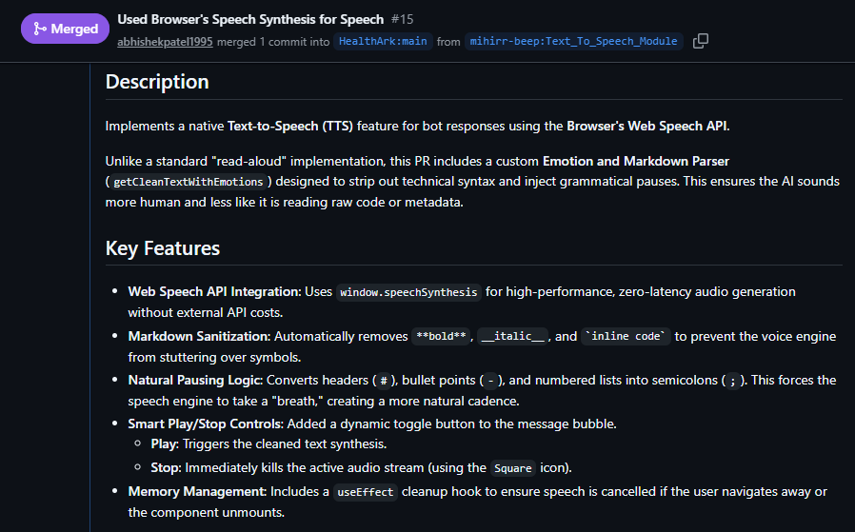

Slide 10
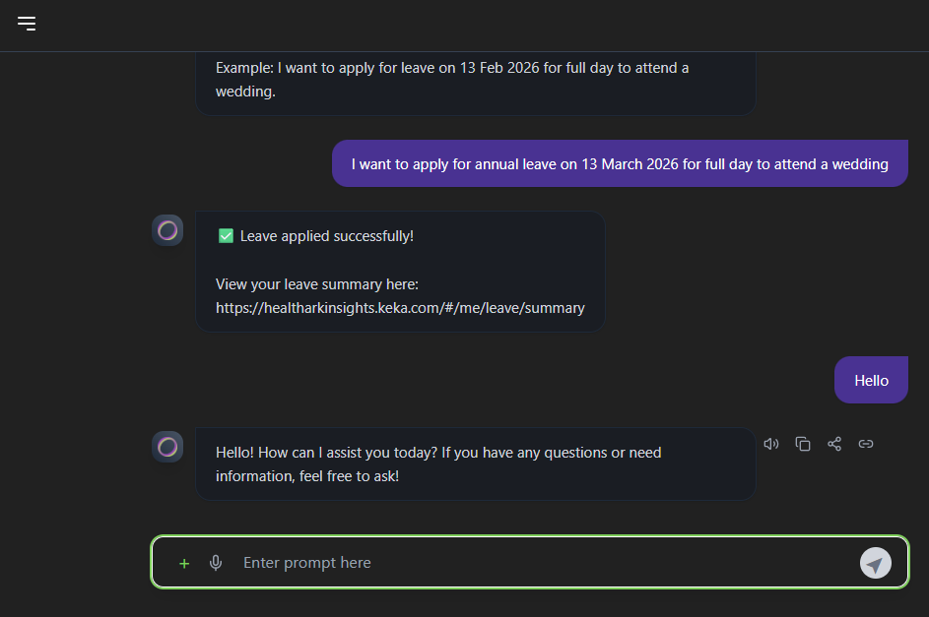

Slide 11
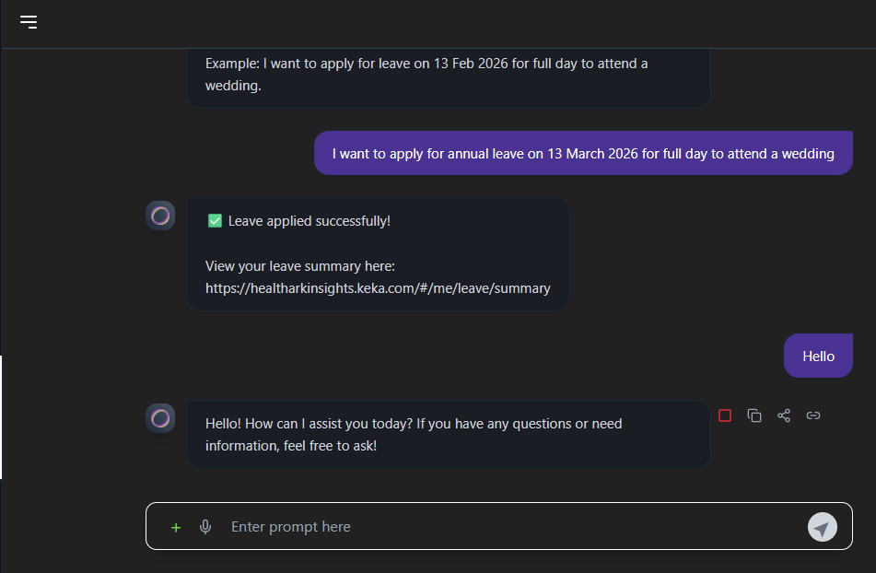

Slide 12
Future workings
Real Time Web Search Module
Using Tavily Search API and DuckDuckGo Search Mixed

